Slide 1
Murach’s Modern JavaScript
Chapter 5
How to code functions and handle events

Slide 2
Objectives
Applied
Code function declarations and arrow functions.
Define default values for function parameters.
Pass parameters to functions and methods using the rest and spread operators.
Create event handlers and attach them to events.
Use the currentTarget property and the preventDefault() method of the Event object to work with events..
Knowledge
Distinguish between arrow functions and function expressions.
Distinguish between global scope, local scope, and block scope.
Briefly describe the Document Object Model (DOM).
Describe when the DOMContentLoaded event occurs and what you typically use it for.

Slide 3
The syntax for a function declaration
function functionName(parameters) {
// statements that run when the function is executed
}
A function declaration with no parameters that doesn’t return a value
function showInvalidMessage() {
alert("That value is invalid. Please try again.");
}
Call the function
showInvalidMessage();

Slide 4
A function declaration with one parameter that returns a value
function toKilometers(miles) {
return miles * 1.60934;
}
Call the function
const kms = toKilometers(100); // kms is 160.934

Slide 5
A function declaration with two parameters that returns a value
function calculateTax(subtotal, taxRate) {
const tax = subtotal * taxRate;
return tax.toFixed(2);
}
Call the function
const salesTax = calculateTax(85, 0.05);
// salesTax = "4.25"

Slide 6
What happens if you call a function declaration before you code it
sayHello(); // prints "Hello" to the console
function sayHello() {
console.log("Hello");
}

Slide 7
The syntax for a function expression
const name = function(parameters) {
// statements that run when the function is executed
};
A function expression with no parameters that doesn’t return a value
const showInvalidMessage = function() {
alert("That value is invalid. Please try again.");
};
Call the function
showInvalidMessage();

Slide 8
A function expression with one parameter that returns a value
const toKilometers = function(miles) {
return miles * 1.60934;
};
Call the function
const kms = toKilometers(100);

Slide 9
A function expression with two parameters that returns a value
const calculateTax = function(subtotal, taxRate) {
const tax = subtotal * taxRate;
return tax.toFixed(2);
};
Call the function
const salesTax = calculateTax(85, 0.05);
// salesTax = "4.25"

Slide 10
What happens if you call a function expression before you code it
sayHello(); // ReferenceError
const sayHello = function() {
console.log("Hello");
};

Slide 11
The syntax for an arrow function
const name = (parameters) => {
// statements that run when the function is executed
};
An arrow function
const calculateTax = (subtotal, taxRate) => {
const tax = subtotal * taxRate;
return tax.toFixed(2);
};
Call the function
const salesTax = calculateTax(85, 0.05);
// salesTax = "4.25"

Slide 12
An arrow function with one parameter
const toKilometers = miles => {
return miles * 1.60934;
};
An arrow function with one parameter that executes one statement
const toKilometers = miles => miles * 1.60934;
An arrow function with no parameters that executes one statement
const sayHello = () => console.log("Hello");

Slide 13
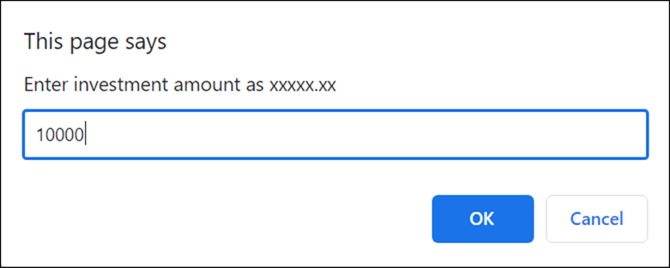
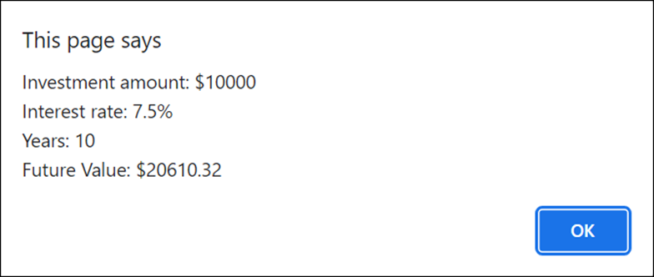
Dialogs for the Future Value app
The first dialog that gets input
The dialog that displays the results

Slide 14
The JavaScript for the Future Value app (part 1)
function getNumber(promptMsg, defaultValue) {
let num = NaN;
while (isNaN(num)) {
num = parseFloat(
prompt(promptMsg, defaultValue));
}
return num;
}
function calcFutureValue(investment, rate, years) {
let futureValue = investment;
for (let i = 0; i < years; i++) {
futureValue += futureValue * rate / 100;
}
return futureValue;
}

Slide 15
The JavaScript for the Future Value app (part 2)
function displayResults(investment, rate, years, futureValue) {
alert("Investment amount: $" + investment + "\n" +
"Interest rate: " + rate + "%\n" +
"Years: " + years + "\n" +
"Future Value: $" + futureValue.toFixed(2));
}
const investment =
getNumber("Enter investment amount as xxxxx.xx",
10000);
const rate =
getNumber("Enter interest rate as xx.x", 7.5);
const years = getNumber("Enter number of years", 10);
const futureValue =
calcFutureValue(investment, rate, years);
displayResults(investment, rate, years, futureValue);

Slide 16
Global scope (not recommended)
const taxRate = 0.074; // declare global constant
let tax = 0; // declare global variable
function calculateTax(subtotal) {
tax = subtotal * taxRate; // use global constant
// and variable
tax = tax.toFixed(2);
}
calculateTax(100);
alert(tax); // tax is "7.40"

Slide 17
Local scope (recommended)
function calculateTax(subtotal, taxRate) {
let tax = subtotal * taxRate; // declare local variable
tax = tax.toFixed(2);
return tax;
}
const tax = calculateTax(100, 0.074);
alert(tax); // tax is "7.40"

Slide 18
Block scope
function displayCount() {
for (let i = 0; i < 5; i++) { // start block
console.log(i); // i in scope
} // end block
console.log(i); // i not in scope –
// ReferenceError
}

Slide 19
A function with a default parameter
function calculateTax(subtotal, taxRate = 0.074) {
const tax = subtotal * taxRate;
return tax.toFixed(2);
}
Call the function
const tax1 = calculateTax(100); // tax1 is "7.40"
const tax2 = calculateTax(100, 0.087); // tax2 is "8.70"
const tax3 = calculateTax(100, null); // tax3 is "0.00"
const tax4 = calculateTax(100, undefined);
// tax4 is "7.40"

Slide 20
An arrow function with a single parameter and a default value
const getPI = (places = 15) =>
Number(Math.PI.toFixed(places));
Call the function
const pi = getPI(); // pi is 3.141592653589793
const pi2 = getPI(4); // pi2 is 3.1416

Slide 21
A function with two parameters that have default values
function toPlaces(num, places = 2, type = "round") {
num = num * (10 ** places); // move decimal point right
if (type == "floor") {
num = Math.floor(num);
} else if (type == "ceil") {
num = Math.ceil(num);
} else {
num = Math.round(num);
}
return num / (10 ** places); // move decimal point left
}

Slide 22
Call the function with two parameters that have default values
const num1 = toPlaces(5.22873); // num1 is 5.23
const num2 = toPlaces(5.22873, 4); // num2 is 5.2287
const num3 = toPlaces(5.22873, 4, "ceil");
// num3 is 5.2288
const num4 = toPlaces(5.22873, "floor");
// num4 is NaN
const num5 = toPlaces(5.22873, undefined, "floor");
// num5 is 5.22

Slide 23
A function with a rest parameter
function calculateTaxAll(taxRate, ...subtotals) {
let tax = 0;
for (let subtotal of subtotals) {
tax += subtotal * taxRate;
}
return tax.toFixed(2);
}

Slide 24
Three ways to call this function
With a list of parameters
const tax1 = calculateTaxAll(0.074, 100); // tax1 is "7.40"
const tax2 = calculateTaxAll(0.074, 100, 200); // tax2 is "22.20"
const tax3 = calculateTaxAll(0.074, 100, 200, 400, 500); // tax3 is "88.80"
With a single spread operator
const taxRateAndAmounts = [0.074, 100, 200, 400, 500];
const tax4 = calculateTaxAll(...taxRateAndAmounts); // tax4 is "88.80"
With multiple spread operators
const rateAndAmounts = [0.074, 100];
const moreAmounts = [200, 400];
const tax5 = calculateTaxAll(...rateAndAmounts,
...moreAmounts, 500); // tax5 is "88.80"

Slide 25
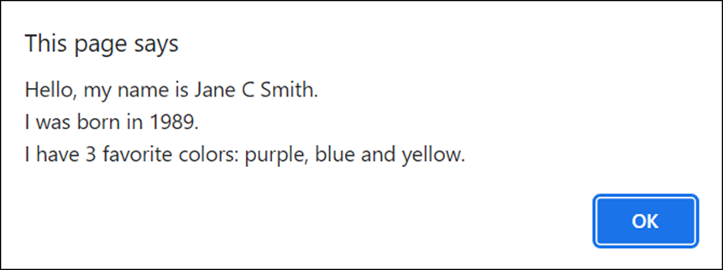
The dialog for the Bio app that displays the user’s bio

Slide 26
The JavaScript for the Bio app (part 1)
function getAsArray(promptMsg, separator = " ") {
return prompt(promptMsg).split(separator);
}
function capitalize(...words) {
const capitalizedWords = [];
for(let word of words) {
const firstLetter =
word.substring(0,1).toUpperCase();
const restOfWord =
word.substring(1).toLowerCase();
capitalizedWords.push(firstLetter + restOfWord);
}
return capitalizedWords;
}

Slide 27
The JavaScript for the Bio app (part 2)
function trim(...items) {
const trimmedItems = [];
for(let item of items) {
trimmedItems.push(item.trim());
}
return trimmedItems;
}
function getColorsString(...items) {
const firstItems = items.slice(0, -1);
const lastItem = items.at(-1);
return `${firstItems.join(", ")} and ${lastItem}`;
}
function displayBio(names, dob, colors) {
alert("Hello, my name is " + names.join(" ") + ".\n" +
"I was born in " + dob.at(-1) + ".\n" +
"I have " + colors.length +
" favorite colors: " +
getColorsString(...colors) + ".");
}

Slide 28
The JavaScript for the Bio app (part 3)
const names =
capitalize(...getAsArray("Enter your full name"));
const dob =
getAsArray("Enter your DOB in mm-dd-yyyy format", "-");
const msg =
"Enter your favorite colors, separated by commas";
const colors = trim(...getAsArray(msg, ","));
displayBio(names, dob, colors);

Slide 29
Common events
Object | Event
window | load
document | DOMContentLoaded
 | keydown
 | keyup
element | click
 | dblclick
 | mouseover
 | mousein
 | mouseout

Slide 30
Two methods available to window, document, and element objects
addEventListener(event, function)
removeEventListener(event, function)
Define and attach an event handler for the DOMContentLoaded event
// define an arrow function and assign it to a constant
const showMessage = () => alert("I'm ready!");
// attach the function to an event
document.addEventListener("DOMContentLoaded",
showMessage);
A more concise way to code the previous example
document.addEventListener("DOMContentLoaded", () =>
alert("I'm ready!") );

Slide 31
A method of the document object
querySelector(selector)
A property available to most elements
textContent
A property available to text boxes
value

Slide 32
The HTML for a text box, button, and label
<input id="text_box" type="text"><br>
<button id="show_button">Show</button><br>
<label id="label"></label>
An event handler
const setLabel = () => {
const label = document.querySelector("#label");
const textBox = document.querySelector("#text_box");
label.textContent = "You entered: " + textBox.value;
};
Code that attaches the event handler to the click event of the button
document.addEventListener("DOMContentLoaded", () => {
const showButton =
document.querySelector("#show_button");
showButton.addEventListener("click", setLabel);
});

Slide 33
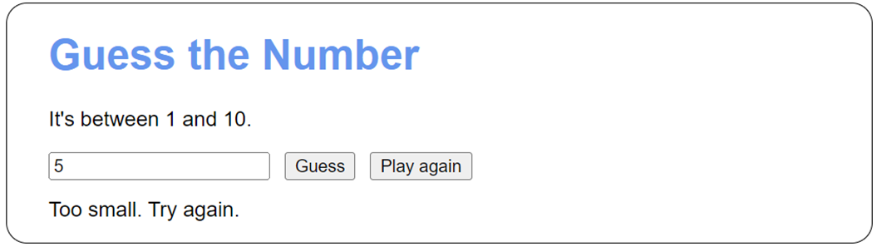
A dialog for the Guess the Number app

Slide 34
The HTML for the Guess the Number app
<!DOCTYPE html>
<html>
<head>
<meta charset="UTF-8">
<meta name="viewport" content="width=device-width,
initial-scale=1">
<title>Guess the Number</title>
<link rel="stylesheet" href="main.css">
</head>
<body>
<h1>Guess the Number</h1>
<p>It's between 1 and 10.</p>
<input type="text" id="number">
<button id="guess">Guess</button>
<button id="play_again">Play again</button><br>
<label id="message"></label>
<script src="guess.js"></script>
</body>
</html>

Slide 35
The CSS for the Guess the Number app
body {
font-family: Arial, Helvetica, sans-serif;
background-color: white;
margin: 1em auto;
width: 600px;
padding: 0 2em 1em;
border: 1px solid black;
border-radius: 1em;
}
h1 {
color: cornflowerblue;
}
input, button {
margin: 0 0.5em 1em 0;
}

Slide 36
JavaScript for the Guess the Number app (part 1)
"use strict";
// global variables
let randomNum = 0;
let tries = 0;
// helper function
const getRandomInt = (max = 100) => {
let num = Math.random() * max;
num = Math.ceil(num);
return num;
};

Slide 37
JavaScript for the Guess the Number app (part 2)
// event handler functions
const guessClick = () => {
const guess = parseInt(document.querySelector(
"#number").value);
let message = "";
if (isNaN(guess)) {
message = "Not a valid number. " +
"Please enter a valid number."
} else if (guess < 1 || guess > 10) {
message = "Invalid number. Enter a number " +
"between 1 and 10.";
} else if (guess < randomNum) {
message = "Too small. Try again.";
tries++;
} else if (guess > randomNum) {
message = "Too big. Try again.";
tries++;

Slide 38
JavaScript for the Guess the Number app (part 3)
} else if (guess === randomNum) {
tries++;
const lastWord = (tries === 1) ? "try" : "tries";
message = `You guessed it in ${tries} ${lastWord}!`;
}
document.querySelector("#message").textContent =
message;
};
const playAgainClick = () => {
randomNum = getRandomInt(10);
tries = 0;
document.querySelector("#number").value = "";
document.querySelector("#message").textContent = "";
};

Slide 39
JavaScript for the Guess the Number app (part 4)
document.addEventListener("DOMContentLoaded", () => {
playAgainClick(); // initialize a new game
document.querySelector("#guess").addEventListener(
"click", guessClick);
document.querySelector("#play_again").addEventListener(
"click", playAgainClick);
});

Slide 40
One property of the Event object
currentTarget
One method of the Event object
preventDefault()
One property of the KeyboardEvent object
key
Common HTML elements that have default actions for the click event
<a>
<input>
<button>

Slide 41
Two HTML <a> elements
<a id="g" href="https://google.com">Google</a>
<a id="fb" href="https://facebook.com">Facebook</a>
An event handler for the click event of both <a> elements
const confirmLeave = event => {
const destination = event.currentTarget.textContent;
const leave = confirm("This is an external website. " +
"Continue to " + destination + "?");
if (!leave) {
event.preventDefault();
}
};
document.addEventListener("DOMContentLoaded", () => {
document.querySelector("#g").addEventListener("click",
confirmLeave);
document.querySelector("#fb").addEventListener("click",
confirmLeave);
});

Slide 42
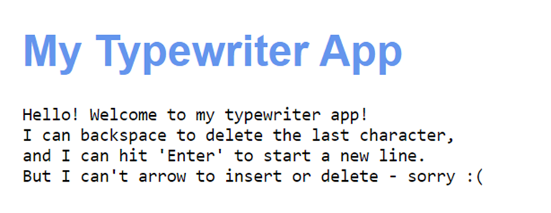
The Typewriter app after a user has typed some content

Slide 43
Some of the HTML for the Typewriter app
<body>
<h1>My Typewriter App</h1>
<pre id="text"></pre>
<script src="typewriter.js"></script>
</body>

Slide 44
The CSS for the Typewriter app
body {
font-family: Arial, Helvetica, sans-serif;
background-color: white;
margin: 1em;
padding: 0 2em 1em;
}
h1 {
color: cornflowerblue;
}

Slide 45
The JavaScript for the Typewriter app
document.addEventListener("DOMContentLoaded", () => {
document.addEventListener("keydown", event => {
const pre = document.querySelector("#text");
const validChars = `abcdefghijklmnopqrstuvwxyz
ABCDEFGHIJKLMNOPQRSTUVWXYZ
1234567890~!@#$%^&*()_+-=\;:'",.`;
if (validChars.includes(event.key)) {
pre.textContent += event.key;
}
else if (event.key.toLowerCase() === "enter") {
pre.textContent += "\n";
}
else if (event.key.toLowerCase() === "backspace") {
pre.textContent = pre.textContent.slice(0, -1);
}
});
});

